Slide 1
LECTURE 1: JAVA BASICS
INF 2105: Software Application Development
LECTURER :MR. AKRAM ALI OMAR
EMAIL: akram.ali.omar@gmail.com
Mobile: 0778695626

Slide 2
LECTURE 1: JAVA BASICS
Write Once, Run Everywhere

Slide 3
Java’s origins
Work on java started in 1991
The goal: a new portable language
Original name: Oak
Original tagline: Write Once, Run Everywhere

Slide 4
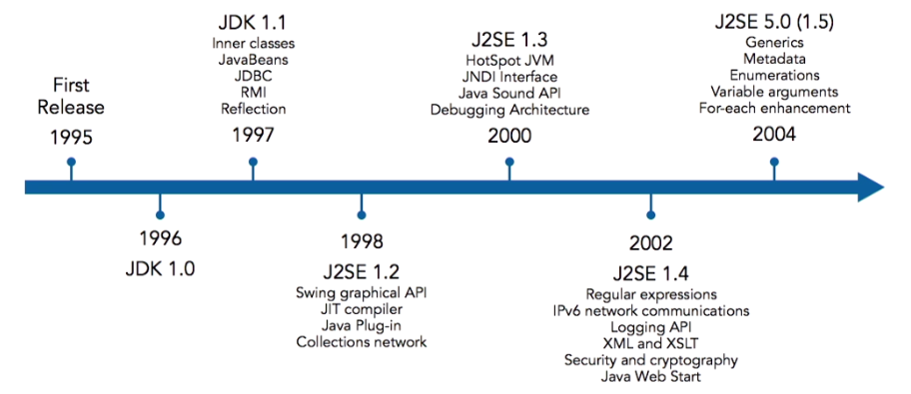
The history of java

Slide 5
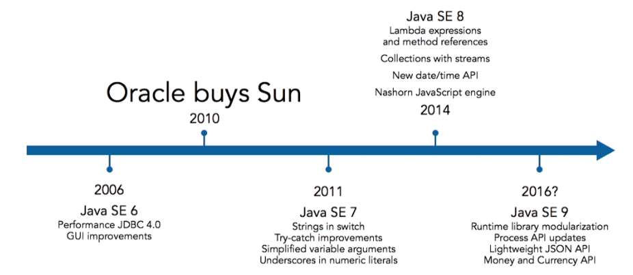
The History of Java

Slide 6
Runtime Architecture
Java is an interpreted language
It compiles to bytecode instead of machine language
The compiled application is portable between platforms without recompiling
Byte code is interpreted, Java code can be executed anywhere an interpreter is available.
The "Interpreter" is call the Java Virtual Machine

Slide 7
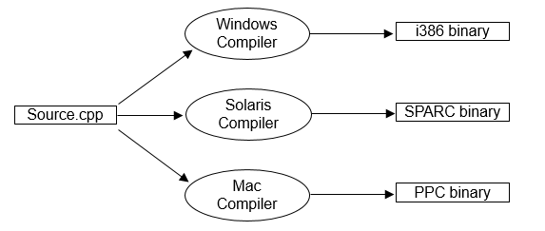
The Java Virtual Machine.
Traditionally, source code had to be compiled for the target hardware and OS platform:

Slide 8
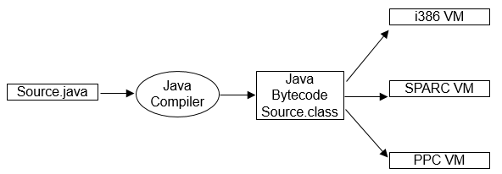
The Java Virtual Machine.
Java source files (.java) are compiled to Java bytecode (.class)
Bytecode is interpreted on the target platform within a Java Virtual Machine
The Java VM does more than interpret bytecode:
The class loader loads appropriate java classes
All classes are verified to contain only legal bytecodes and not permitted any illegal stack or register usage

Slide 9
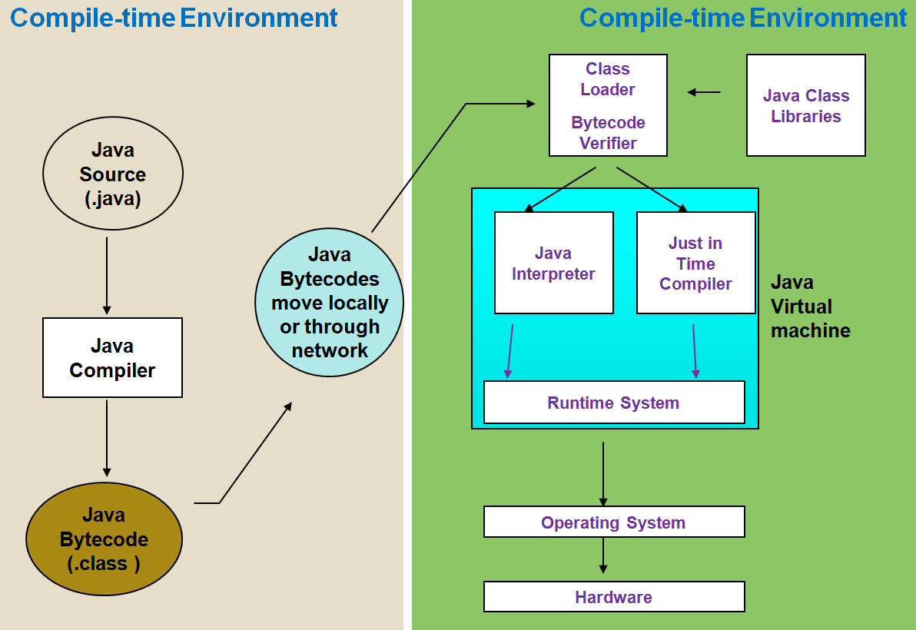
How it works…!

Slide 10
Java Editions
Java Platform, Standard Edition(SE)
Standard for core language and runtime environment(JRE)
Java Platform, Enterprise Edition(EE)
Standard for building industrial-strength web applications
Java Platform, Micro Edition (ME)
Micro-controllers, sensors, and mobile devices

Slide 11
Java SE Development Kit(JDK)
Availablee at no cost from Oracle
Includes tools for compilation and packaging
java: runtime
javac: compiler
javadoc: docs builder
jar: archive builder

Slide 12
Choosing a Development Environment
Any text editor will do it
But many java IDEs are available
On OS X
BDEdit and TextWrangler: not a java “specialis”t IDE
On windows:
TextPad
JCreator

Slide 13
Top Cross- Platform IDEs
NetBeans
Excellent support for JEE development
Also supports C, C++, and PHP
Eclipse with Java Developer tools
Free and open source
Distributions for many languages and platform
IntelliJ IDEA
Free “community” edition, paid “pro” edition
Foundation of Google’s Android Studio

Slide 14
Java Basic Syntax
JAVA CLASSES:
All code is defined in classes
Classes are defined in source code files with .java extension
The javac command compiles Java code into bytecode
The java command runs compiled bytecode files.

Slide 15
Java Basic Syntax
Simple Java Program:
Let us look at a simple code that would print the words ”I rule!”.
Class declaration
public class MyFirstApp {
public static void main(String []args) { System.out.println("I rule!");
}
}
Main method
Executable code

Slide 16
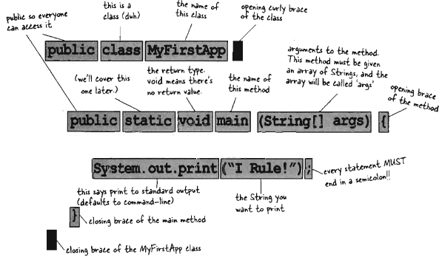

Slide 17
how to save the file, compile and run the program.
Let's look at how to save the file, compile and run the program. Please follow the steps given below:
Open notepad and add the code as above.
Save the file as: MyFirstApp.java.

Slide 18
how to save the file, compile and run the program.
Open a command prompt window and go o the directory where you saved the class. Assume it's C:\.
Type ' javac MyFirstApp.java ' and press enter to compile your code. If there are no errors in your code, the command prompt will take you to the next line (Assumption : The path variable is set).

Slide 19
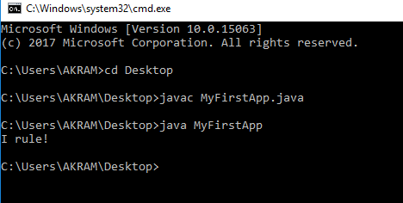
how to save the file, compile and run the program.
Now, type ' java MyFirstApp' to run your program.
You will be able to see ‘I rule!' printed on the window.

Slide 20
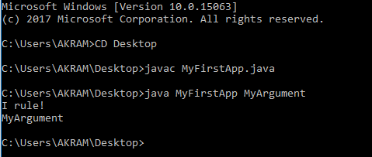
Parsing Arguments to a console application
public class MyFirstApp {
public static void main(String []args) { System.out.println("I rule!");
System.out.println(args[0]);
}
}

Slide 21
COMMENTS IN JAVA
Comments start with: //
Comments ignored during program execution
Document and describe code
Provides code readability
Multiple line comments: /* ... */
/* This is a multiple
line comment. It can
be split over many lines */
Another line of comments
Note: line numbers not part of program, added for reference

Slide 22

Basic Syntax:
About Java programs, it is very important to keep in mind the following points.
Case Sensitivity
Java is case sensitive, which means identifier Hello and hello would have different meaning in Java.
White space
white space doesn’t affect interpretation of code
space, tabs, and line feeds are “collapsed” by compiler
All statements must end with must end with semicolon(;).

Slide 23
Basic Syntax:
Class Names
For all class names the first letter should be in Upper Case.
If several words are used to form a name of the class, each inner word's first letter should be in Upper Case.
Example class MyFirstApp

Slide 24
Basic Syntax:
Method Names
All method names should start with a Lower Case letter.
If several words are used to form the name of the method, then each inner word's first letter should be in Upper Case. Example public void myMethodName()
public static void main(String args[])
Java program processing starts from the main() method which is a mandatory part of every Java program.
Constants are all uppercase

Slide 25
Basic Syntax:
Program File Name
Name of the program file should exactly match the class name.
When saving the file, you should save it using the class name (Remember Java is case sensitive) and append '.java' to the end of the name (if the file name and the class name do not match your program will not compile).
Example : Assume 'MyFirstApp' is the class name. Then the file should be saved as' MyFirstApp.java'

Slide 26
Java Identifiers:
All Java components require names. Names used for classes, variables and methods are called identifiers.
In Java, there are several points to remember about identifiers. They are as follows:
All identifiers should begin with a letter (A to Z or a to z), currency character ($) or an underscore (_).

Slide 27
Java Identifiers:
After the first character identifiers can have any combination of characters.
A key word cannot be used as an identifier.
https://docs.oracle.com/javase/tutorial/java/nutsandbolts/_keywords.html
Most importantly identifiers are case sensitive.
Examples of legal identifiers: age, $salary, _value, __1_value
Examples of illegal identifiers: 123abc, -salary

Slide 28
Using Character Escape Codes
There are some characters that will cause problems in your code if typed explicitly, such as the carriage return or double
Quotation mark. Typing these directly into your code where you want them to print is problematic and would most likely cause compiler errors.
For example
System.out.println(“Some people call me “Joey”.”); //compile error

Slide 29
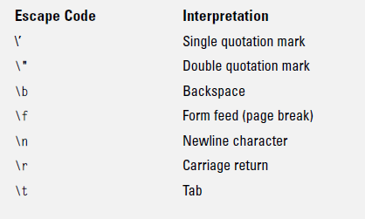
CHARACTER ESCAPE CODES
System.out.println(“Some people call me \”Joey\”.”); //no error

Slide 30
Primitive Types and Variables
Boolean, char, byte, short, int, long, float, double etc.
These basic (or primitive) types are the only types that are not objects (due to performance issues).
This means that you don’t use the new operator to create a primitive variable
Declaring primitive variables:
float initVal;
int retVal = 2;
double gamma = 1.2;
boolean valueOk = false;

Slide 31
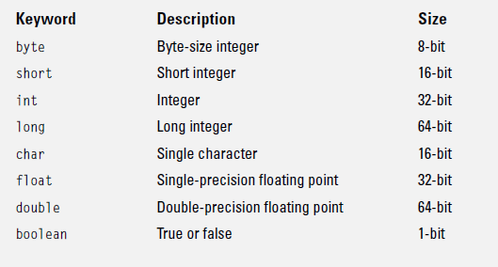
Primitive Types and Variables

Slide 32
Primitive Variable & Reference Variable
When you think of java variable, think of a container that holds something.
This container (java variable) has size and a type.
Primitive containers (variables) have different sizes and those sizes have names.
Each primitive variable has a fixed number of bits (container size).
A cups´size analogy of the six numeric primitives variables in Java are shown below

Slide 33
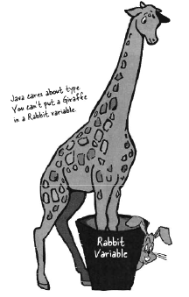
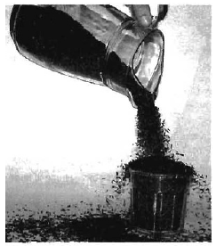
Primitive Variable & Reference Variable
Java cares about types, you can´t put different things in a different type of a container.
E.g. Rabbit b = new Giraffe();
Don´t expect this to compile!!!
You can´t put a large value into a small
byte b = 1500;
// this will never work.

Slide 34
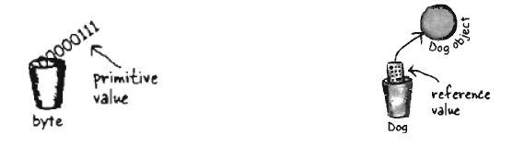
Primitive Variable & Reference Variable
You know how to declare a primitive variable and assign it a value.
But now what about non-primitive variables? In other words, what about objects?
There is actually no such thing as an object variable, there's only an object reference variable.
It doesn't hold the object itself, It holds bits that represent a way to access an object
You can't put (store) an object into a variable.

Slide 35
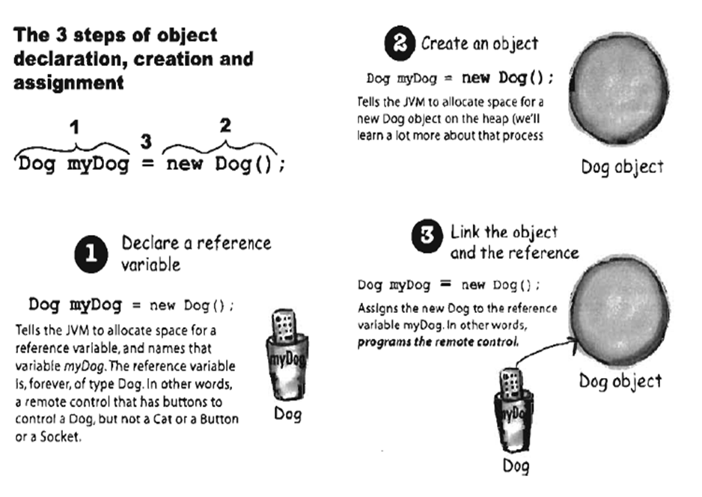

Slide 36
Initialisation
If no value is assigned prior to use, then the compiler will give an error
Java sets primitive variables to zero or false in the case of a Boolean variable
All object references are initially set to null
An array of anything is an object
Set to null on declaration
Elements to zero false or null on creation

Slide 37
MEMORY MANAGEMENT AND GARBAGE COLLECTION
Objects are born and objects die. You're in charge of an object's Iifecycle.
You decide when and how to construct it.You decide when to destroy It.
Except you don't actually destroy the object yourself, you simply abandon it. But once it 's abandoned, the heartless Garbage Collector, can vaporize it, reclaiming the memory that object was using .
When writing java programs, you will be creating objects. Sooner or later, you´ve to let some of them go, or risk running out of RAM.

Slide 38
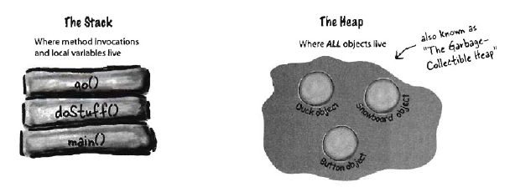
The Stack and the Heap: Where things live
When a JVM starts up, it gets a chunk of memory from the underlying OS, and uses it to run your Java program.
In java, we (programmers) care about two areas of memory
The one where objects live (the heap), and the one where method invocations and local variables live (the stack).

Slide 39
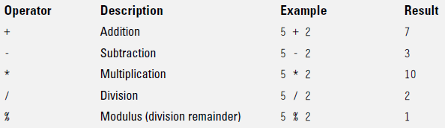
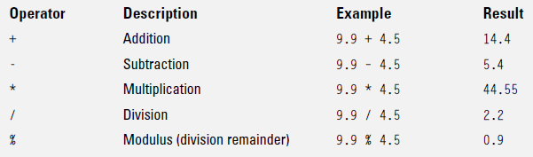
MATHEMATICAL OPERATORS:
INTEGER MATH
FLOATING POINT MATH

Slide 40
Operator Precedence
Operator precedence determines the order in which operations are applied to numbers.
In general, multiplication (*), division (/), and modulus (%) have precedence over addition (+) and subtraction (–).
This means that multiplication, division, and modulus operations are evaluated before addition and subtraction. When operator precedence is the same, operations occur from left to right

Slide 41
Operator Precedence
Example
int x = 10 – 4 + 14 / 2;
The value of x will be 10 if it evaluated strictly left to right.
10 – 4 = 6; 6 + 14 = 20; 20 / 2 = 10.
Because the division operator is evaluated first, the value of this expression is 13. (10 – 4 + 7 = 13).
Therefore the correct value of x is 13;

Slide 42
Enforcing operator precedence
There is a way to force operator precedence using parentheses (like in Algebra).
The operations within parentheses have precedence
int y = (10 – 4 + 14) / 2;

Slide 43
Relational and Conditional Operators
Compares two values and determines the relationship between them
Operator | Use | Returns true if
> | op1 > op2 | op1 is greater than op2
>= | op1 >= op2 | op1 is greater than or equal to op2
< | op1 < op2 | op1 is less than op2
<= | op1 <= op2 | op1 is less than or equal to op2
== | op1 == op2 | op1 and op2 are equal
!= | op1 != op2 | op1 and op2 are not equal

Slide 44
Relational and Conditional Operators
Used to construct decision making expressions
Operator | Use | Returns true if
&& | op1 && op2 | op1 and op2 are both true, conditionally evaluates op2
|| | op1 || op2 | either op1 or op2 is true, conditionally evaluates op2
! | ! op | op is false
& | op1 & op2 | op1 and op2 are both true, always evaluates op1 and op2
| | op1 | op2 | either op1 or op2 is true, always evaluates op1 and op2
^ | op1 ^ op2 | if op1 and op2 are different--that is if one or the other of the operands is true but not both

Slide 45
Assignment Operators
Basic assignment operator (=) is used to assign one value to another
Shortcut Assignment Operators
Operator | Use | Equivalent to
+= | op1 += op2 | op1 = op1 + op2
-= | op1 -= op2 | op1 = op1 - op2
*= | op1 *= op2 | op1 = op1 * op2
/= | op1 /= op2 | op1 = op1 / op2
%= | op1 %= op2 | op1 = op1 % op2
&= | op1 &= op2 | op1 = op1 & op2

Slide 46
Working with primitives values
NOTE: When you are working with primitives you can make a copy of the values but you can not create a reference to the original values
In this example we have two copies of the values
int intValue1 =5;
int intValue2 = intValue1;

Slide 47
Converting numeric values
Two types of conversion:
Widening conversion: conversion of the value from a type that uses small amount of memory to a type the uses large amount of memory
int intValue1 =5;
long longValue2 = intValue1;//widening conversion

Slide 48
Converting numeric values
Narrowing conversion
Is the conversion of the value from a type that uses large amount of memory to a type the uses small amount of memory
Use type casting to narrowing type
Work fine if the original value is compatible with both types
But wont’s work if the original value in not compatible with new type
int intValue1 =5;
shot shortValue2 = (short)intValue1;//narrowing conv.
int intValue1 =1500;
byte byteValue2 = (short)intValue1;//narrowing conv.

Slide 49
Interactive programs
We have written programs that print console output, but it is also possible to read input from the console.
The user types input into the console. We capture the input and use it in our program.
Such a program is called an interactive program.
Interactive programs can be challenging.
Computers and users think in very different ways.
Users misbehave.

Slide 50
Input and System.in
System.out
An object with methods named println and print
System.in
not intended to be used directly
We use a second object, from a class Scanner, to help us.
Constructing a Scanner object to read console input:
Scanner name = new Scanner(System.in);
Example:
Scanner console = new Scanner(System.in);

Slide 51
Java class libraries, import
Java class libraries: Classes included with Java's JDK.
organized into groups named packages
To use a package, put an import declaration in your program.
Syntax:// put this at the very top of your program
import packageName.*;
Scanner is in a package named java.util
import java.util.*;
To use Scanner, you must place the above line at the top of your program (before the public class header).

Slide 52
Java class libraries, import
Java class libraries: Classes included with Java's JDK.
organized into groups named packages
To use a package, put an import declaration in your program.
Syntax: // put this at the very top of your program
import packageName.*;
Scanner is in a package named java.util
import java.util.*;
To use Scanner, you must place the above line at the top of your program (before the public class header).

Slide 53
Example Scanner usage
import java.util.*; // so that I can use Scanner
public class ReadSomeInput {
public static void main(String[] args) {
Scanner console = new Scanner(System.in);
System.out.print("How old are you? ");
int age = console.nextInt();
System.out.println(age + "... That's quite old!");
}
}
Output (user input underlined):
How old are you? 14
14... That's quite old!
Notes:
It's also useful to write a program that prompts for multiple values, both on the same line or each on its own line.

Slide 54
Another Scanner example
import java.util.*; // so that I can use Scanner
public class ScannerSum {
public static void main(String[] args) {
Scanner console = new Scanner(System.in);
System.out.print("Please type three numbers: ");
int num1 = console.nextInt();
int num2 = console.nextInt();
int num3 = console.nextInt();
int sum = num1 + num2 + num3;
System.out.println("The sum is " + sum);
}
}
Output (user input underlined):
Please type three numbers: 8 6 13
The sum is 27
The Scanner can read multiple values from one line.
Notes:
It's also useful to write a program that prompts for multiple values, both on the same line or each on its own line.

Slide 55
Other Scanner Class Methods
Method | Example
nextShort | short num1; num1=keyboard.nextShort();
nextInt | int num2; num2=keyboard.nextInt();
nextLong | long num3; num3=keyboard.nextLong();
Scanner keyboard = new Scanner(System.in);

Slide 56
Other Scanner Class Methods
nextByte | byte x; x=keyboard.nextByte();
nextFloat | float num4; num4=keyboard.nextFloat();
nextDouble | double num5; num5=keyboard.nextDouble();
nextLine | String name; name=keyboard.nextLine();

Slide 57
Flow of control
Java executes one statement after the other in the order they are written
Many Java statements are flow control statements:
Alternation: if, if else, switch
Looping: for, while, do while
Escapes: break, continue, return

Slide 58
If-Else Statement
The if … else statement evaluates an expression and performs one action if that evaluation is true or a different action if it is false
if (expression) {
statement(s)
} else {
statement(s)
}
Eg 1.
if (x<y) {
System.out.println(“y is greater than x”);
} else if (x>y) {
System.out.println(“x is greater than y”);
} else {
System.out.println(“x and y are equal”);
}

Slide 59
If-Else Statement
Eg 2.
if (x<y) {
System.out.println(“y is greater than x”);
} else if (x>y) {
System.out.println(“x is greater than y”);
} else {
System.out.println(“x and y are equal”);
}

Slide 60
If-Else Statement
Exercise
Write a program to calculate the grade of a student given the average
Marks < 0 or Marks > 100 give Error Message
0 <= Marks < 40 – Grade = C
40 <= Marks < 70 – Grade = B
70 <= Marks <= 100 – Grade = A
Hints
Write a class with a main method

Slide 61
Nested if … else
if ( person ==“student” ) {
if ( education ==“primary”) {
System.out.println(“he/she is primary student”);
}
else {
System.out.println(“he/she is not primary student”);
}
}
else
{
System.out.print(“he/she is not student”);
}

Slide 62
A Warning…
WRONG!
if( i == j )
if ( j == k )
System.out.print(“i equals k”);
else
System.out.print(
“i is not equal to j”);
CORRECT!
if( i == j ) {
if ( j == k )
System.out.print(“i equals k”);
}
else
System.out.print(“i is not equal to j”); // Correct!

Slide 63
Ternary operator (op1 ? op2 : op3 )
Shortcut if-else statement
op1 ? op2 : op3
returns op2 if op1 is true or returns op3 if op1 is false
Example:
variable x = (expression) ? value if true: value if false
int a, b;
a = 10;
b = (a == 1) ? 20: 30;
System.out.println( "Value of b is : " + b );

Slide 64
Switch Statement
Evaluates a variable and executes statements according to it’s value
switch (variable) {
case value1: statement(s);
break;
case valueN: statement(s);
break;
case default: statement(s);
break;
}

Slide 65
Switch Statement
Eg.
Exercise
Write a program to output the following
Grade = A – ‘Very Good’
Grade = B – ‘Good’
Grade = C – ‘Bad
switch (day) {
case 1: System.out.println(“Sunday”); break;
case 2: System.out.println(“Monday”); break;
case 3: System.out.println(“Tuesday”); break;
case 4: System.out.println(“Wednesday”); break;
case 5: System.out.println(“Thursday”); break;
case 6: System.out.println(“Friday”); break;
case 7: System.out.println(“Saturday”); break;
default: System.out.println(“Invalid Day”); break;
}

Slide 66
For loop
To repeat an operation several times
for (initialization; termination; increment) { statement(s)
}
Eg
Loop n times
for ( i = 0; i < n; n++ ) {
// this code body will execute n times
// ifrom 0 to n-1
}
for ( j = 0; j < 10; j++ ) {
for ( i = 0; i < 20; i++ ){
// this code body will execute 200 times
}
}

Slide 67
For loop
Nested for:
for ( j = 0; j < 10; j++ ) {
for ( i = 0; i < 20; i++ ){
// this code body will execute 200 times
}
}

Slide 68
For loop
Exercise
Write a program to calculate the factorial of a given integer

Slide 69
While and Do-While Statements
Continuously executes some statements while a condition remain true
while (expression) {
statement(s)
}
do {
statement(s)
} while (expression);

Slide 70
While and Do-While Statements
Eg.
int x=0;
while (x<5) {
System.out.println(“Iteration ” + x);
x++;
}
int x=0;
do {
System.out.println(“Iteration ” + x);
x++;
} while (x<5);

Slide 71
While and Do-While Statements
Exercise
Write a method to calculate the factorial of a positive integer
Using a While Loop
Using a Do-While Loop

Slide 72
Branching Statements
break
Used to terminate a switch statement or a loop
Eg.
int x=0;
while (true) {
System.out.println(“Iteration ” + x);
x++;
if (x==5) {
break;
}
}

Slide 73
Branching Statements
continue
Used to skip a part of an iteration in a loop
Eg.
int x=0;
while (x<5) {
x++;
if (x==2) {
continue;
}
System.out.println(“Iteration ” + x);
}

Slide 74

Arrays
Am array is a list of similar things
An array has a fixed:
name
type
length
These must be declared when the array is created.
Arrays sizes cannot be changed during the execution of the code
myArray has room for 8 elements
the elements are accessed by their index
in Java, array indices start at 0

Slide 75
Declaring Arrays
int myArray[];
declares myArray to be an array of integers
myArray = new int[8];
sets up 8 integer-sized spaces in memory, labelled myArray[0] to myArray[7]
int myArray[] = new int[8];
combines the two statements in one line

Slide 76
Assigning Values
Refer to the array elements by index to store values in them.
myArray[0] = 3;
myArray[1] = 6;
myArray[2] = 3; ...
Can create and initialise in one step:
int myArray[] = {3, 6, 3, 1, 6, 3, 4, 1};
Access an Array
System.out.println(myArray[2]);

Slide 77
Iterating Through Arrays
for loops are useful when dealing with arrays:
for (int i = 0; i < myArray.length; i++) {
System.out.println(myArray[i]);
}

Slide 78
The foreach Loops(jdk 1.5)
for loops are useful when dealing with arrays:
for (int element: myArray) {
System.out.println(element);
}

Slide 79
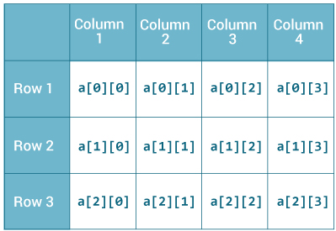
Arrays - Multidimensional
Here, a is a two-dimensional (2d) array. The array can hold maximum of 12 elements of type int.
int [][]arr=new int[3][4]
arr[0][0] =1;
arr[0][1] =5;
arr[0][2] =7;
arr[0][3] =6;
arr[1][0] =34;
arr[1][1] =41;
arr[1][2] =4;
arr[1][3] =-7;
arr[2][0] =3;
arr[2][1] =9;
arr[2][3] =2;
arr[2][3] =8;

Slide 80
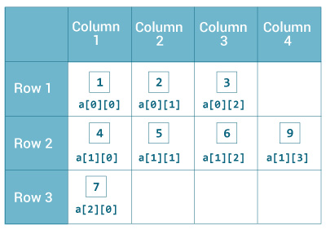
initialize a 2d array in Java?
int[][] a = {
{1, 2, 3},
{4, 5, 6, 9},
{7},
};

Slide 81
Print all elements of 2d array Using Loop
class MultidimensionalArray {
public static void main(String[] args) {
int[][] a = {
{1, -2, 3},
{-4, -5, 6, 9},
{7},
};
for (int i = 0; i < a.length; ++i) {
for(int j = 0; j < a[i].length; ++j) {
System.out.println(a[i][j]);
}
}
}
}

Slide 82
END

